Slide 1

quadSquad
The Bletchley code breakers

Slide 2
Hello!
Team:
Viktor Kavaldzhiev, 10v
Magdalena Omayska, 10v
Vasil Stanchev, 10v
Yoana Stoyanova, 10v

Slide 3
Stages of realization

Slide 4
Planning
Realization
Presentation

Slide 5
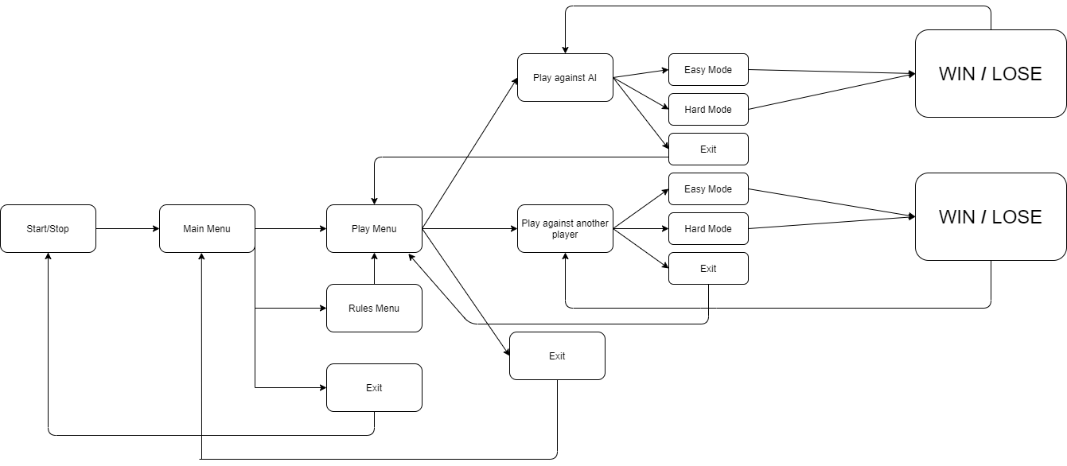
Diagram for our program

Slide 6
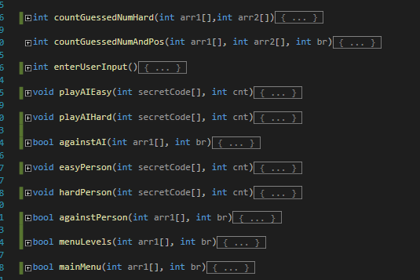
The functions and files that we used

Slide 7






USED TECHNOLOGIES

Slide 8
Thanks!

Slide 9

Now it's time for our GAME

